Slide 1
GIT Emergencies

Slide 2
A 69-year-old woman presents to the emergency department with 1 day history of melena. She has a history of rheumatoid arthritis, diabetes mellitus, and hypertension. Her medications include methotrexate, metformin, aspirin 81 mg, and ibuprofen 400 mg three times daily. On physical examination, her vital signs are as follows: Temperature 37° C Blood pressure 80/55 mm Hg Heart rate 120 bpm Respiratory rate 12 breaths/min Her abdominal exam is soft and non-tender. Laboratory values are as follows: Hemoglobin 8 g/dL WBC 7000/μL Platelet count 190,000/μL Total bilirubin 1.8 mg/dL Creatinine 1.5 mg/dL INR 1.3 She is adequately resuscitated with IV normal saline, and her blood pressure increases to 105/85 mm Hg and heart rate drops to 92 bpm. The emergency department physician starts an omeprazole drip. An endoscopy is planned in the morning.

Slide 5
A 60-year-old man presents to the emergency department with 1 day history of hematemesis and melena. He has a history of osteoarthritis, diabetes mellitus, and hypertension. He has a remote history of hepatitis C, which was treated successfully in the 1990s. His medications include metformin, glimepiride, aspirin 81 mg, and ibuprofen 400 mg three times daily. On physical examination, his vital signs are as follows: Temperature 36° C Blood pressure 90/55 mm Hg Heart rate 110 bpm Respiratory rate 12 breaths/min His abdominal exam is soft and nontender. Laboratory studies are as follows: Hemoglobin 7.5 g/dL WBC 6000/μL Platelet count 290,000/μL Total bilirubin 1.4 mg/dL Creatinine 1.2 mg/dL INR 1.8 Which of the following recommendations is correct for this patient’s management?
A. IV octreotide should be started in the emergency department
B. Blood transfusion is indicated to a hemoglobin of at least 9 g/dL
C. Endoscopy should be delayed until the INR is corrected to 1
D. I.V. 0.9% NS

Slide 6
A 50-year-old woman with chronic NSAID use for osteoarthritis of her knees is admitted to the hospital for hematemesis. She reports a history of epigastric burning sensation with regurgitation worse with spicy foods. On physical examination, her vital signs are as follows: Temperature 37° C Blood pressure 90/50 mm Hg Heart rate 130 bpm Respiratory rate 12 breaths/min Her abdominal exam is soft and with mild epigastric tenderness. Laboratory studies are as follows: Hemoglobin 7 g/dL WBC 8000/μL Platelet count 190,000/μL Total bilirubin 1.9 mg/dL Creatinine 1.4 mg/dL INR 1.2 She is given IV fluids and an EGD is performed. A large 4 cm gastric ulcer is noted in the antrum with an adherent clot. There is some oozing of blood around the clot. Which of the following is the most appropriate next step in management?
A. No further endoscopic therapy, start proton pump inhibitor drip
B. Dual endoscopic therapy and proton pump inhibitor drip for 72 hours
C. Remove clot with a snare and treat underlying lesion and start IV proton pump inhibitor
D. Send the patient to interventional radiology for further therapy
E. Inject epinephrine around the clot to stop oozing and give patient IV proton pump inhibitor

Slide 7
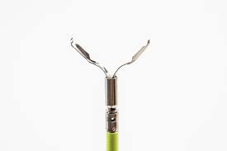
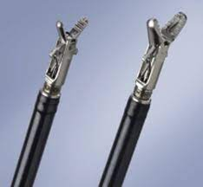
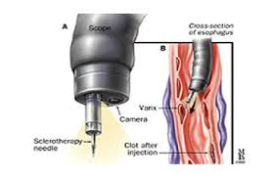
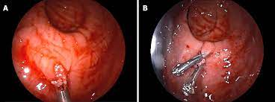

Slide 8
A 58-year-old woman presents to the emergency department with light-headedness and a history of several bloody bowel movements over the past 24 hours. She denies any abdominal pain. She is hypotensive and anemic. Resuscitative measures are instituted. Both the upper endoscopy and colonoscopy are not diagnostic, but she continues to pass clots per rectum. Her hematocrit is 33%. What is the most effective management strategy?
A. Capsule endoscopy
B. Abdominal CT scan with contrast
C. Scintigraphy and angiography
D. MRI
E. Emergency surgery

Slide 9
A 57-year-old man with known chronic hepatitis C is brought by his wife to the emergency department, with two hours history of haematemesis and melena .
How you would continue with this patient ?

Slide 13
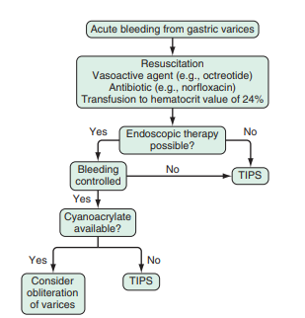
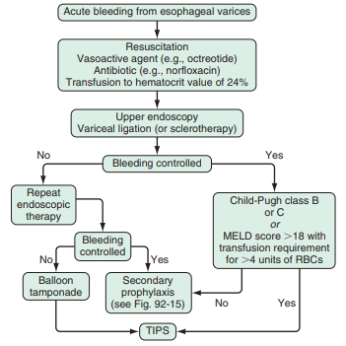

Slide 14
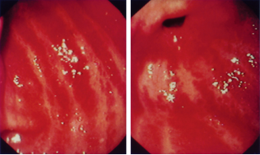

Slide 15
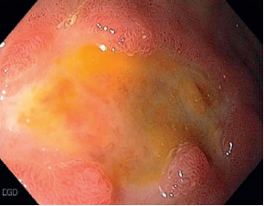
What is the lesion ?

Slide 17
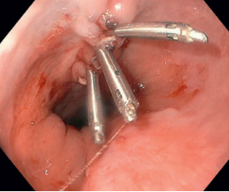

Slide 18
A 26-year-old woman is seen in the emergency department with acute onset epigastric pain, nausea, and vomiting. She has had similar episodes of pain over the past 2 years. She denies alcohol, tobacco, or drug use. On physical exam she has a temperature of 98° F, blood pressure of 100/50 mm Hg, and heart rate of 110 bpm. Abdominal exam reveals tenderness in the epigastrium. Laboratory values are as follows: WBC 15,000/μL ALT 20 U/L AST 19 U/L Alkaline phosphatase 120 U/L Total bilirubin 2.2 mg/dL Lipase 2000 IU/L She is started on intravenous fluids and intravenous analgesia. A right upper quadrant ultrasound reveals no gallstones. An MRCP is performed (see figure). Which of the following is the most appropriate next step in management?

Slide 29
Different scoring systems
RANSON
APACHPE
BISAP

Slide 30
A 55-year-old man with a history of alcohol abuse presents with worsening epigastric pain for the last 2 days. His abdomen is tender to palpation in the epigastrium. Laboratory studies reveal elevated amylase and lipase. Abdominal CT scan reveals interstitial pancreatitis with peripancreatic inflammatory changes without necrosis. The patient is admitted to the floor, started on IV fluids, IV analgesia, and kept NPO. He improves over the next 48 hours and is discharged uneventfully. He is seen in clinic 2 months later with mild epigastric discomfort. He denies nausea, vomiting, or weight loss. A repeat CT scan reveals a new low attenuation cystic lesion with a thin wall adjacent to the body of the pancreas measuring 7 cm. Which of the following is the most appropriate next step in management?
A. Conservative management
B. CT-guided aspiration of the cyst
C. Start ciprofloxacin and metronidazole
D. Obtain a surgical consult
E. Endoscopic cystgastrostomy

Slide 32
A 40-year-old Caucasian woman with a history of Crohn’s disease presents with abdominal pain, nausea, and vomiting. She reports passing loose stool two times per day with occasional rectal bleeding. Medication history reveals that the patient takes amlodipine 10 mg orally daily and was started on azathioprine (150 mg) and infliximab (5 mg/kg) 6 weeks ago. She denies drinking alcohol or smoking. Physical exam shows the following: Temperature 99° F Heart rate 95 bpm Respiratory rate 16 breaths/min Blood pressure 105/65 mm Hg Her abdomen is tender to palpation in the epigastrium. Laboratory values are as follows: AST 40 U/L ALT 35 U/L Bilirubin 1.0 mg/dL Triglycerides level 320 mg/dL Lipase 1000 U/L Ultrasound of the right upper quadrant reveals no gallstones. Which of the following is the most likely cause of the patient’s symptoms?
A. Crohn’s colitis flare
B. Amlodipine
C. Azathioprine
D. Infliximab
E. Alcohol

Slide 33
A 35-year-old woman presents to the emergency department with nausea, vomiting, and epigastric pain of 6-hour duration. Significant past medical history includes hypertension for which she takes lisinopril. Physical exam shows the following: Temperature 97° F Heart rate 105 bpm Respiratory rate 15 breaths/min Blood pressure 120/65 mm Hg Her abdomen is distended and is tympanic to percussion. There is tenderness to deep palpation in the epigastrium. Abdominal ultrasound reveals cholelithiasis. CBD was 6 mm in diameter. Laboratory values are as follows WBC 11,000/μL Hematocrit 40% Hemoglobin 14 g/dL Calcium 7.2 mg/dL ALT 75 U/L AST 83 U/L Alkaline phosphatase 180 U/L Bilirubin 2.5 mg/dL Amylase 1200 IU/L BUN 20 mg/dL Which of the following is the most appropriate next step in management?
A. Abdominal CT scan
B. Fluid resuscitation
C. Wide-spectrum IV antibiotics
D. ERCP
E. Insert nasogastric (NG) tube

Slide 34
A 68-year-old man presents with jaundice, abdominal pain, and fevers of 3 days duration. Physical exam reveals tenderness in the right upper quadrant. Laboratory values are as follows: WBC 18000/μL Alkaline phosphatase 870 U/L ALT 130 U/L AST 160 U/L Total bilirubin 9.2 mg/dL Direct bilirubin 7.2 mg/dL Creatinine 1.1 mg/dL INR 1.2 Amylase 50 IU/L , abdominal uls dilated CBD with 103mm impacted stone?
How you will manage this patient ?

Slide 36
1.NPO
2. I.V. FLUID
03. ANTIBIOTICS
4. ANALGESIA
5.OTHER

Slide 37
24 year old male patient with preceding three days hx of nausea , vomiting and jaundice , brought today to the emergency department with altered conscious level ?
How you continue with this patient ?

Slide 42
Encephalopathy
Intracranial Hypertension and Cerebral Edema:
Cerebral edema has been a hallmark complication of ALF, major cause of death, and threat to successful LT
Hemodynamic Changes and Circulatory Failure
Infection
Renal Failure
Hematologic Abnormalities

Slide 43
A 57-year-old man with known chronic hepatitis C is brought by his wife to the emergency department. He is obtunded and unable to provide any history. The wife reports that he started to experience a marked increase in his abdominal girth in the last 3 weeks and yesterday complained of abdominal pain and tremors. He was having one to two daily loose bowel movements that were brown and nonbloody. He underwent an upper endoscopy 3 months ago, which was remarkable for mild portal hypertensive gastropathy, with no gastroesophageal varices. He never suffered any episode of confusion before. He is naïve to hepatitis C therapy and his only current medication was furosemide 20 mg daily and spironolactone 100 mg daily. No recent use of alcohol or any toxic habits were reported. His vital signs are as follows: Temperature 37.8° C Blood pressure 90/70 mm Hg Heart rate 105 bpm Respiratory rate 22 breaths/min

Slide 44
Hepatic encephalopathy in the setting of CLD

Slide 45
A 24-year-old pregnant woman at 14 weeks of gestation is brought to the emergency department due to altered mental status. Her husband reports that the patient started complaining of abdominal pain and worsening abdominal distention over the preceding day. Her past medical history is significant for factor V Leiden deficiency and a prior history of deep vein thrombosis (DVT). On exam she has tense ascites, hepatomegaly, and scleral icterus. Her laboratory values are as follows ALT 1200 U/L AST 1329 U/L Bilirubin 5 mg/dL INR 2.8 Ammonia level 154 mcg/dL WBC 8700/μL Hematocrit 32% A Doppler ultrasound shows absence of flow in all hepatic veins.. What is the next most appropriate step in the management? A. Start anticoagulation with heparin B. Urgent transjugular intrahepatic portosystemic shunt C. Surgery to create a Porto-systemic shunt D. Urgent liver transplant evaluation E. Symptomatic treatment with lactulose and diuretics

Slide 46
You determine that this is a fulminant presentation of Budd-Chiari syndrome

Slide 47
A 51-year-old woman with a history of hypertension and hypothyroidism presents to your office with a 3-day history of nausea, vomiting, and abdominal pain. She normally suffers from constipation, and she has not had a bowel movement in more than a week. She reports taking her levothyroxine and lisinopril regularly. She took her usual magnesium hydroxide for constipation, but it did not help. Her past medication history includes partial small bowel resection for a benign hamartoma. Her abdomen is distended, and a plain film is obtained (see figure). Which of the following is the most appropriate next step in management

Slide 49
A 57-year-old woman presents to the emergency department with a 1-day history of nausea, vomiting, and crampy abdominal pain. Her past medical history is significant for diabetes mellitus, hypertension, and cervical osteoarthritis. Her surgical history is significant for a total abdominal hysterectomy. In the emergency department her abdomen is distended, bowel sounds are decreased, and her abdomen is diffusely tender. An abdominal plain film is shown (see figure). Which of the following is the most likely etiology of the patient’s presentation?
A. Crohn’s stricture
B. Intraabdominal adhesions Small and Large Intestine
C. Narcotic-induced ileus
D. Bowel intussusception
E. Radiation-induced injury

Slide 50
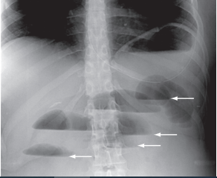

Slide 51
A 38-year-old woman with a 1-year history of panulcerative colitis presents to the emergency department. She notes worsening bloody diarrhea and a weight loss of 18 pounds over the past 8 weeks. She has been on 60 mg of prednisone during this time, along with mesalamine 4.8 g/day. Her vitals signs are as follows: Temperature 101.5° F Heart rate 120 bpm Blood pressure 100/50 mm Hg Her abdominal exam reveals mild tenderness to palpation in the left lower quadrant without rebound or guarding, hypoactive bowel sounds, and no hepatosplenomegaly. Her laboratory values are notable for the following: Hemoglobin 6.8 g/dL Albumin 1.6 g/dL C-reactive protein 100.8 mg/dL Which of the following is the most appropriate next step in management? A. Start methylprednisolone 100 mg intravenously daily B. Obtain plain film of abdomen C. Start metronidazole D. Start infliximab E. Start cyclosporine

Slide 52
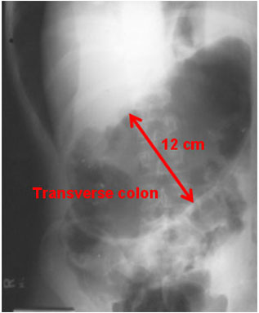

Slide 56
A 78-year-old woman is seen in the emergency department with abrupt, painless bright red blood per rectum that started 4 hours prior to presentation. She describes passing large amount of clots per rectum followed by light-headedness and dizziness. On physical exam, vital signs are as follows: Blood pressure 80/60 mm Hg Heart rate 120 bpm , She continues to pass bright red blood per rectum. An angiography of the superior mesenteric artery is shown (see figure). What is the next best step in management?
Surgical consultation for segmental colectomy
B. Embolization
C. Colonoscopic evaluation
D. Admit to intensive care unit for resuscitation
E. Intravenous vasoconstrictors

Slide 57
A 48-year-old man presents to the emergency department with sudden onset left lower quadrant abdominal pain and persistent emesis that woke him up from sleep. He is febrile to 38.6° C. Physical exam reveals localized tenderness in the left lower quadrant, without rebound tenderness or guarding. CT scan with intravenous contrast shows bowel wall thickening in the sigmoid colon with pericolonic fat stranding. What is the best antibiotic regimen for him? A. Oral metronidazole B. Oral levofloxacin + oral trimethoprim/ sulfamethoxazole C. Intravenous amoxicillin/clavulanate D. Intravenous clindamycin + intravenous metronidazole E. Intravenous metronidazole + intravenous vancomycin

Slide 58
The patient is clearly obtunded, with decrease of breath sounds on bases, and a distended abdomen with a fluid wave and shifting dullness consistent with tense ascites. Rectal exam is remarkable for a boggy prostate gland and brown stool on the rectal vault. The patient is intubated and placed on mechanical ventilation and started on intravenous fluids Laboratory studies are obtained and the patient transferred to the intensive care unit. A head CT performed earlier revealed involutional changes consistent with mild chronic encephalomalacia but no acute pathology. Which of the following is the most appropriate next step in management? A. Start lactulose by nasogastric tube and reassess neurological status once the patient achieves more that three bowel movements daily B. Decrease calorie protein intake to less than 1 gm/kg daily C. Start rifaximin 550 mg orally twice daily D. Perform a diagnostic and therapeutic paracentesis, order blood culture and ascitic fluid cultures, and start empiric broad-spectrum antibiotics E. Place the patient on an extracorporeal albumin dialysis using a molecular absorbent recirculation system (MARS)

Slide 59
A 30-year-old man with a 6-year history of pancolitis secondary to ulcerative colitis presents to you with 2 weeks of increasing rectal bleeding and diarrhea. The blood is red and mixed with the stool. His disease had previously been in steroid-free remission for 3 years on maintenance dose of oral mesalamine. He is hemodynamically stable at this visit. In addition to evaluating for progression of disease, what is the most important test to perform?
A. Stool testing for Clostridium difficile
B. Stool testing for H. pylori
C. CT scan of the abdomen
D. Stool testing for occult blood E. Upper endoscopy

Slide 60
A 56-year-old man with past medical history of hypertension and atrial fibrillation presents to the emergency department with complaints of sudden onset severe abdominal pain in the periumbilical area for the past 2 hours. He had an episode of black tarry stools also at that time. His medications include aspirin and losartan. Vital signs were as follows: Temperature 100° F Respiratory rate 20 breaths/min Heart rate 100 bpm Blood pressure 90/60 mm Hg He rates his abdominal pain as 10/10. On physical examination, he appears acutely ill. His abdominal exam shows mild tenderness in the midabdomen. Rectal exam shows melena. What is the next best step in diagnosing this condition?
A. CT scan of the abdomen
B. Esophagogastroduodenoscopy (EGD)
C. Emergency laparotomy
D. Admit to hospital for observation
E. Obtain abdominal x-ray

Slide 61
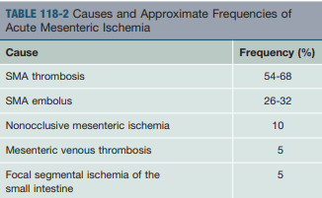
ACUTE MESENTERIC ISCHEMIA
What is the Ix ?
The classic description of “pain out of proportion to abdominal findings

Slide 63
RISK FACTORS:
in patients older than 50 years who have longstanding congestive heart failure (myocardial infarction, or hypotension. The development of sudden abdominal pain in a patient with any of these risk factors should suggest the diagnosis of AMI. particularly if the heart failure is poorly controlled), cardiac arrhythmias, recent
Treatment Our approach to the management of AMI is based on several observations. First, if the diagnosis is not made before intestinal infarction

Slide 64
A 20-year-old woman presents to the hospital with severe lower abdominal pain that started abruptly an hour ago. She was treated for vaginal Chlamydia infection in the past 3 weeks. Her last menstrual period was 2 months ago. Vital signs were as follows: Blood pressure 90/60 mm Hg Heart rate 110 bpm Respiratory rate 16 breaths/min On physical examination, she appears in moderate distress. Physical exam revealed tenderness in the lower abdomen. Laboratory exam was significant for hemoglobin of 9 g/ dL. Urine pregnancy test is positive. Pelvic ultrasound suggests a tubal pregnancy. The patient’s nurse goes to talk to her about the results and witnesses that she turns pale and collapses suddenly. What is the most likely diagnosis?

Slide 65
Thanks

